Slide 1
TODO
Lada’s tests -> approval test (of the list) -> better printing
Full printed story -> whitespace -> json
Pretty printed json -> inline -> everywhere
everywhere -> single instance -> some can’t convert
dual conversations (.and) -> some can’t convert v2 -> setting state

Slide 2
Better Testing with Approvals
Llewellyn Falco
Lada Kesseler

Slide 3
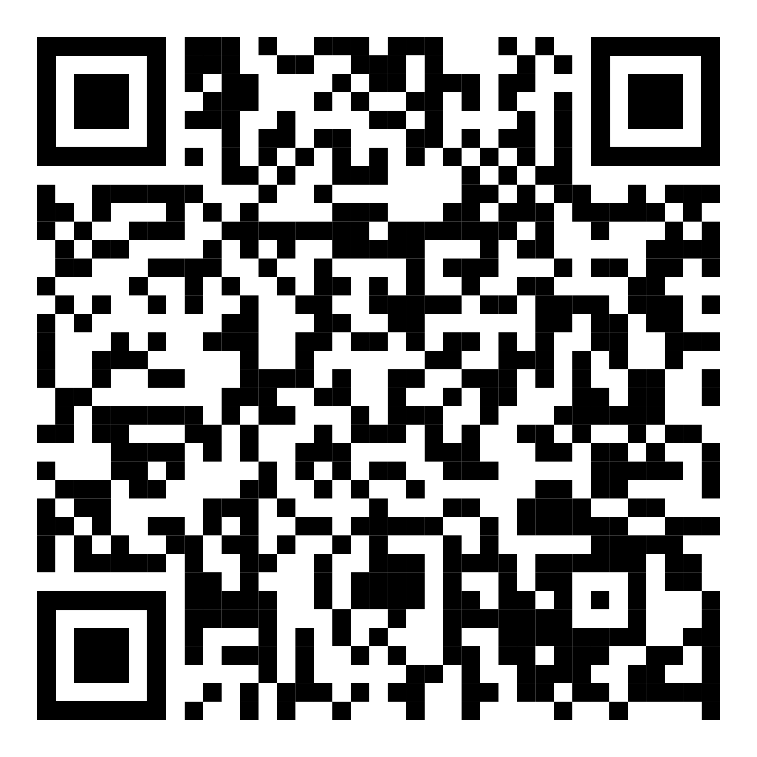
Resources
Notes:
https://github.com/isidore/Talks/blob/master/BetterTestingWithApprovals.md

Slide 4
“People don’t know what they want,
until they see what they don’t.”
- Alan Shalloway

Slide 5
The story so far
Lada: lead developer working on the message bot application
Llewellyn: technical coach working with Lada and work on some tests

Slide 6

In the beginning...

Slide 7
code

Slide 8
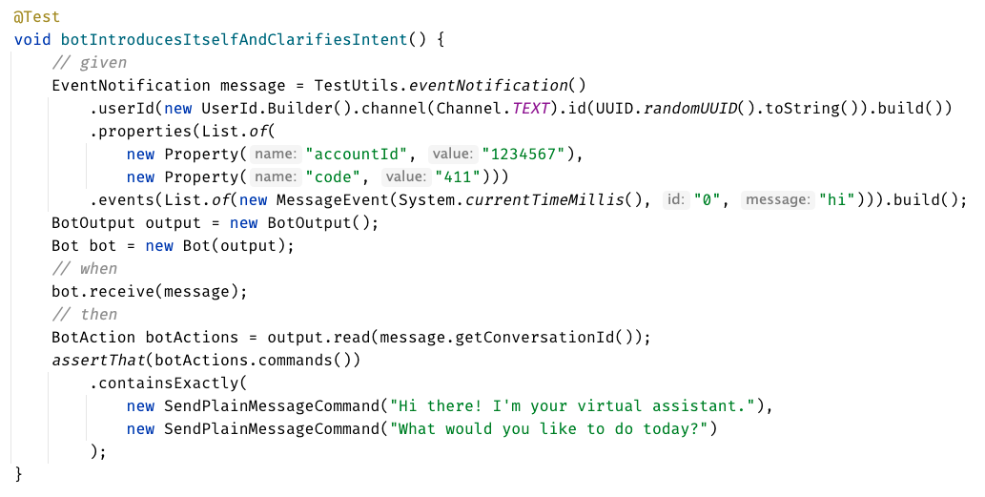
Original Test

Slide 9
?? WHAT IS THIS ??
Chat
[Customer]
hi
[Bot]
Hi there! I'm your virtual assistant.
What would you like to do today?

Slide 11
// Create side (0,0) – (3,4)
// Verify length
Whiteboard
English
Testing Circle
Result
Code
Side (0,0) – (3,4) length = 5
Side s = new Side(0,0,3,4);
Approvals.Verify(s + “ length = “ +s.Length);

Slide 12
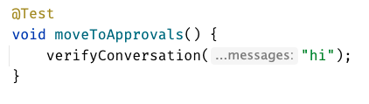

Chat
[Customer]
hi
[Bot]
Hi there! I'm your virtual assistant.
What would you like to do today?
Customer says ‘hi’
verify the conversation
English
Whiteboard
Result
Code

Slide 13
Chat
[Customer]
hi
[Bot]
Hi there! I'm your virtual assistant.
What would you like to do today?
Customer says ‘hi’
verify the conversation
English
Whiteboard
Result
Code
[Customer]: hi

Slide 14
...later that week...

Slide 15
Formatting
[Customer]: hi [Bot]: Hi there! I'm your virtual assistant. [Bot]: What would you like to do today?
[Customer]: hi [ Bot]: Hi there! I'm your virtual assistant. [ Bot]: What would you like to do today?

Slide 16
Formatting
[Customer]: hi [Bot]: Hi there! I'm your virtual assistant. [Bot]: What would you like to do today? [Customer]: hi [Bot]: Hmmm, tell me a little more so I can help you. What would you like to do today? [Customer]: hi [Bot]: Let me try to help you. [Bot]: Are you a customer? 1) Yes, I'm a customer 2) No, I'm not
[Customer]: hi [ Bot]: Hi there! I'm your virtual assistant. [ Bot]: What would you like to do today? [Customer]: hi [ Bot]: Hmmm, tell me a little more so I can help you. [ ]: What would you like to do today? [Customer]: hi [ Bot]: Let me try to help you. [ Bot]: Are you a customer? [ ]: 1) Yes, I'm a customer [ ]: 2) No, I'm not

Slide 17
?? WHAT IS THIS ??
Chat
[Customer]
hi
[Bot]
Hi there! I'm your virtual assistant.
What would you like to do today?
[Customer]
pay bill
[Bot]
Are you a customer?
Yes, I'm a customer No, I'm not

Slide 18
...later that week...

Slide 19
// Create side (0,0) – (3,4)
// Verify length
Whiteboard
English
Testing Circle
Result
Code
Side (0,0) – (3,4) length = 5
Side s = new Side(0,0,3,4);
Approvals.Verify(s + “ length = “ +s.Length);

Slide 20
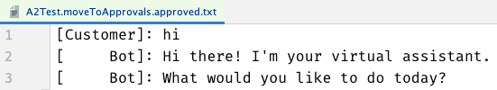
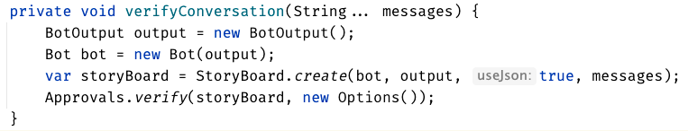

Slide 21
testing circle

Slide 23
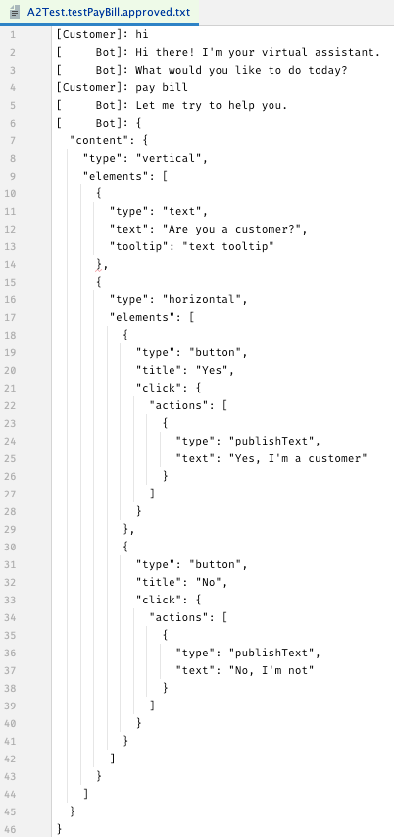
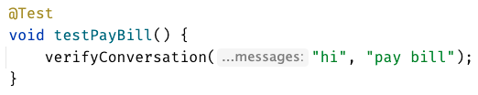

Slide 24
[Customer]: hi [ Bot]: Hi there! I'm your virtual assistant. [ Bot]: What would you like to do today? [Customer]: pay bill [ Bot]: Let me try to help you. [ Bot]: { "content": { "type": "vertical", "elements": [ { "type": "text", "text": "Are you a customer?", "tooltip": "text tooltip" }, { "type": "horizontal", "elements": [ { "type": "button", "title": "Yes", "click": { "actions": [ { "type": "publishText", "text": "Yes, I'm a customer" } ] } }, { "type": "button", "title": "No", "click": { "actions": [ { "type": "publishText", "text": "No, I'm not" } ] } } ] } ] } }

Slide 25
[Customer]: hi [ Bot]: Hi there! I'm your virtual assistant. [ Bot]: What would you like to do today? [Customer]: pay bill [ Bot]: Let me try to help you. [ Bot]: Are you a customer? [ ]: 1) Yes, I'm a customer [ ]: 2) No, I'm not

Slide 26
...later that week...

Slide 27
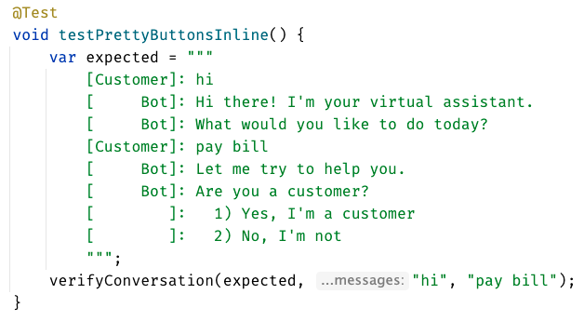
inline - everything in test

Slide 28
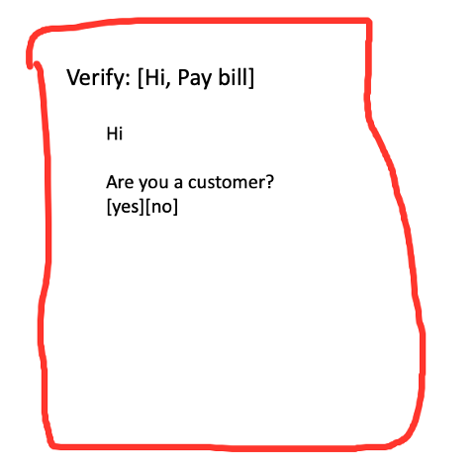
lots of tests – most of them work
different test – in old test format

Slide 29
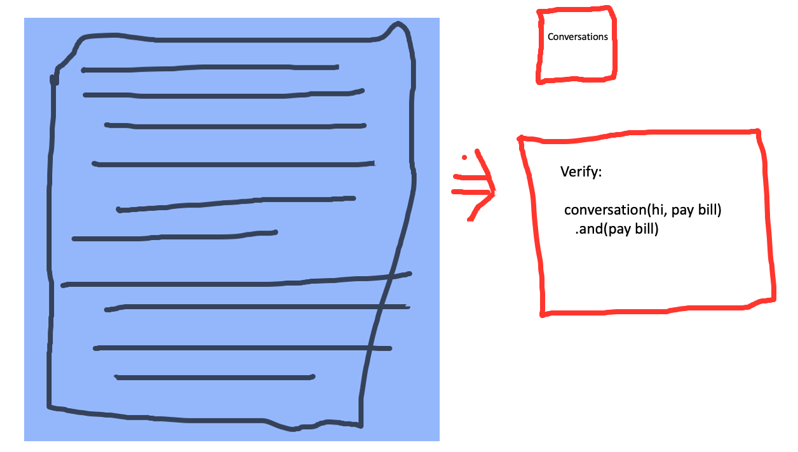

Slide 30
lots of tests – most of them work
different test – in old test format

Slide 31
lots of tests –all of them work
consistency in all of our tests

Slide 32
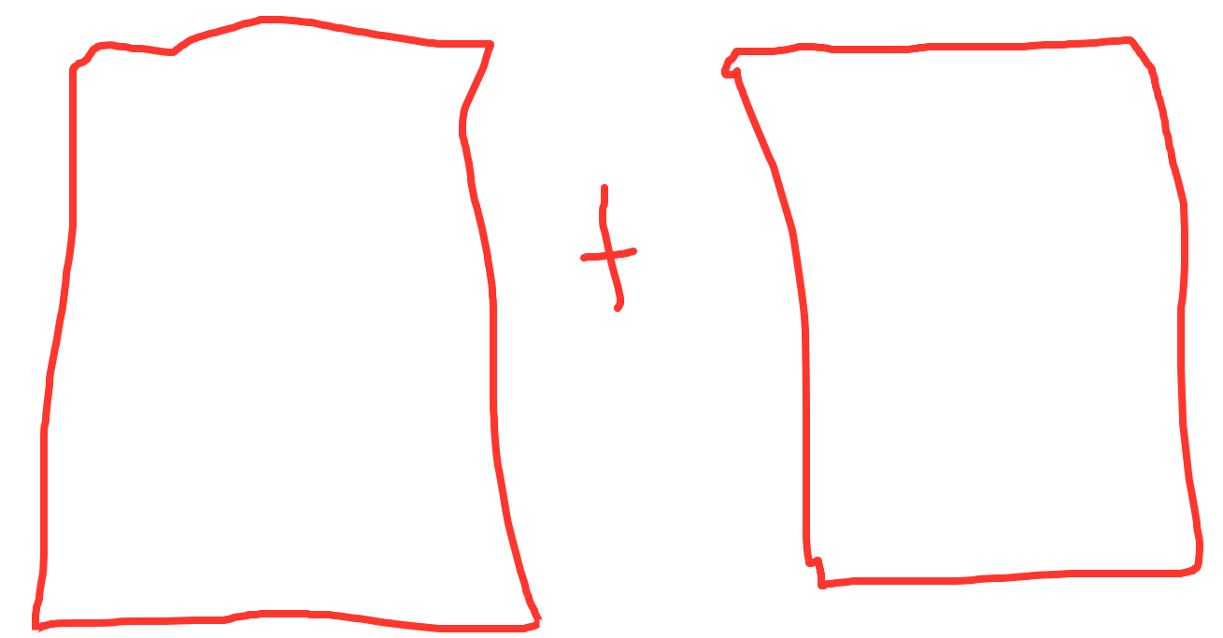
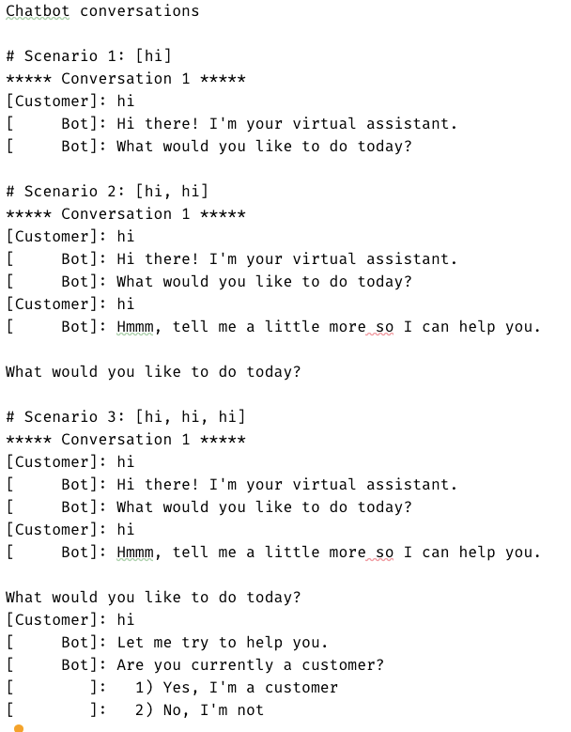
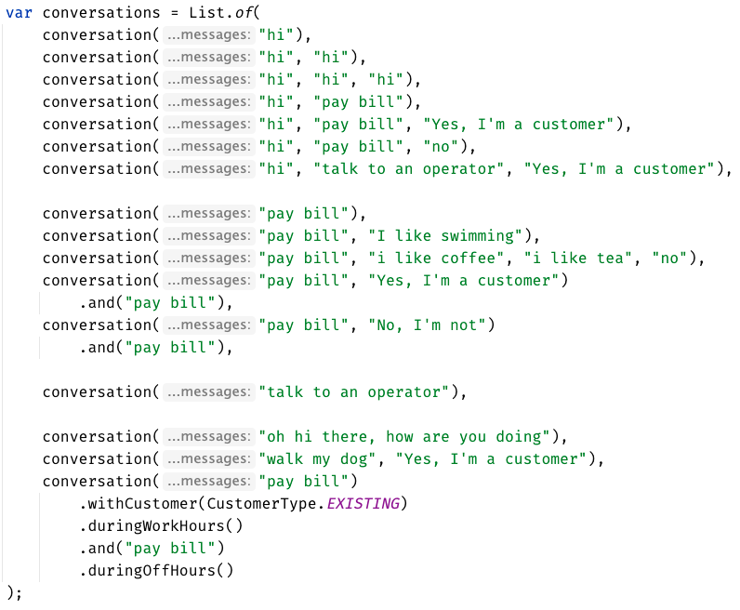
Much easier to see the big picture
Approved
how do they relate to each other? what’s the differences? grouping

Slide 33
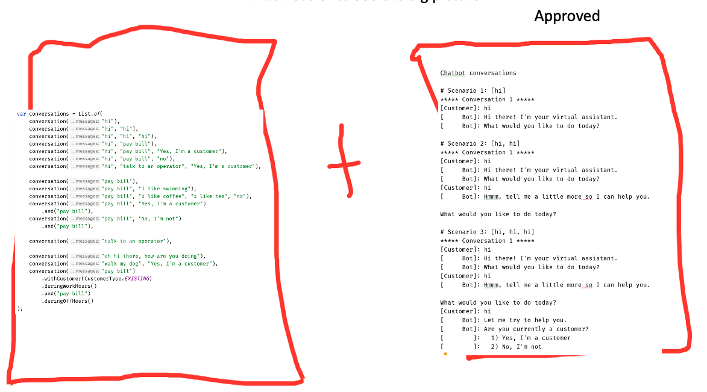
Much easier to see the big picture
we still have this one
in the new format
messy setup – needed config
messy setup

Slide 34
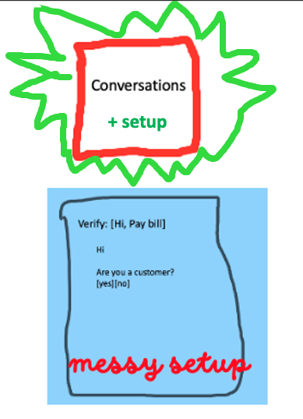

Slide 35
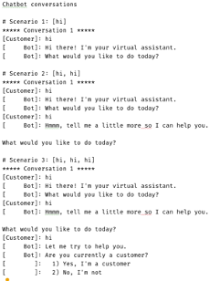
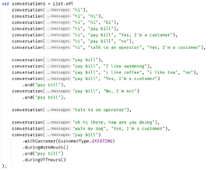
Much easier to see the big picture
Approved
how do they relate to each other? what’s the differences? grouping

Slide 36
can see only
up to here
foggy
as the details disappear,
we get to see the next layer
person

Slide 37
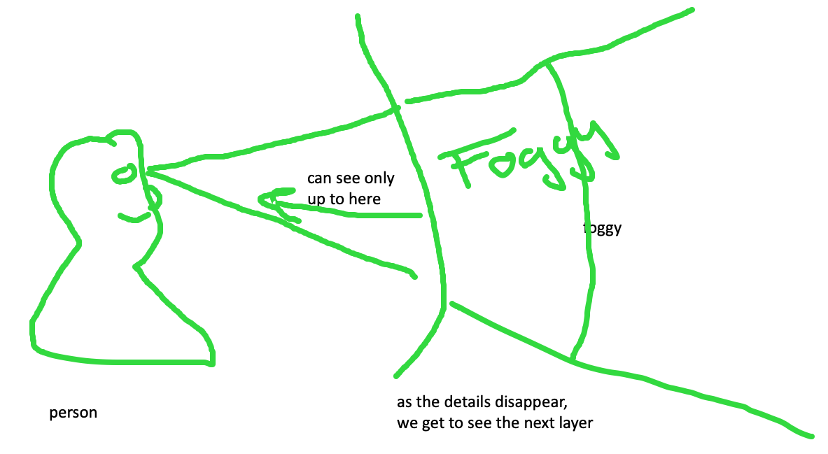
feedback loop – too hard and impossible is the same thing, stop to look

Slide 38
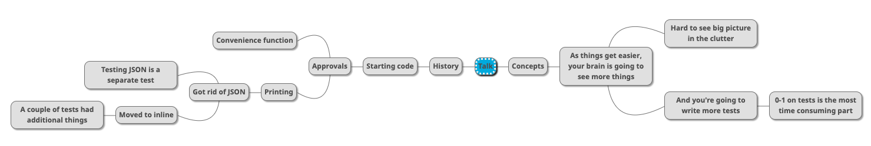

Slide 40
Rest Calls

Slide 41
Consider paths we took:
wordy Java tests
made a printer
made a good printer – not a json: Json test // TODO the json tests
made the inlining – makes it easier to read the whole test better
did multiple conversations
now we can see individual tests, but we can’t see the big picture – so we moved it to the uber test – can delete the other files

Slide 42
Original
@Test public void shouldGetCustomerFromService() { // given accountType = CustomerAccountTypeInfo.builder().account(ACCOUNT_ID).accountType(”PERSONAL").subscription(”MONTHLY").build(); when(responseEntity.getBody()).thenReturn(accountType); // when CustomerAccount result = customerService.retrieveAccount(ACCOUNT_ID); // then CustomerAccount expectedCustomerAccount = new CustomerAccount(ACCOUNT_ID, CustomerPaymentType.MONTHLY, "PERSONAL"); assertThat(result, is(expectedCustomerAccount)); verify(restTemplate, times(1)).exchange(calledUrlCaptor.capture(), eq(HttpMethod.GET), sentHttpEntityCaptor.capture(), any(Class.class)); verifyHeadersAreValid(sentHttpEntityCaptor.getValue().getHeaders()); }

Slide 43
Approval Text
Recorded call to : Conversation Details API
REQUEST
--------------------------------------------------------------------------------
Method : GET
Called Url: /api/v1.2/message/id/500
Headers :
{
"Authorization" : [ "Basic fake" ],
"Cache-Control" : [ "no-cache" ]
}
Body :
null
EXAMPLE RESPONSE
--------------------------------------------------------------------------------
{
"data": [
{
"displayNumber": "500",
"encodedCaseDisposition": 27,
"uuid": "uuid-1",
"createDate": 0,
"responsePortalLink": "/portal/message/500",
"primaryMessage": {
"conversationDisplayId": "500",
"network": "twitter",
"networkInstance": "twitter",
"receiveDate": 0,
"publishDate": 0,
"tags": [
],
"private": true
},
"messages": [
{
"conversationDisplayId": "500",
"network": "twitter",
"networkInstance": "twitter",
"receiveDate": 0,
"publishDate": 0,
"tags": [
],
"private": true
}
],
"tags": [
{
"creator": {
"type": "BOT"
},
"tagId": "34",
"uuid": "uuid2"
}
],
"priority": 4,
"lswPermalink": "/console/bot/500",
"totalResponses": 2,
"hasResponse": false,
"status": "IN_PROGRESS"
}
]
}

Slide 44
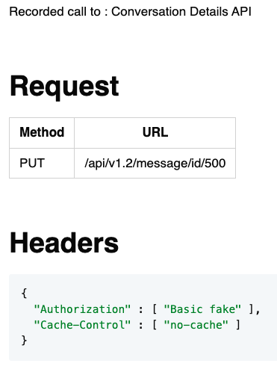
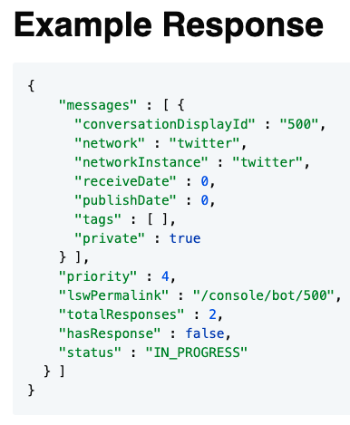
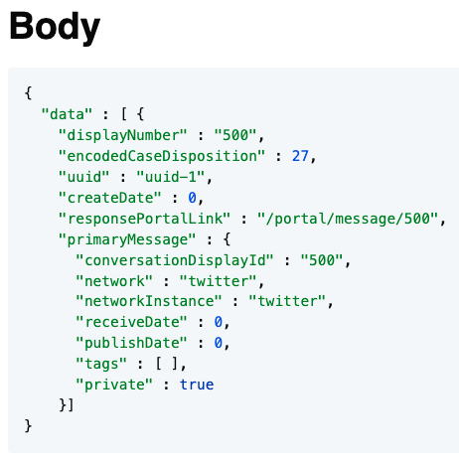
Approval Markdown
2-5 min - Lightning talk?

